Slide 1
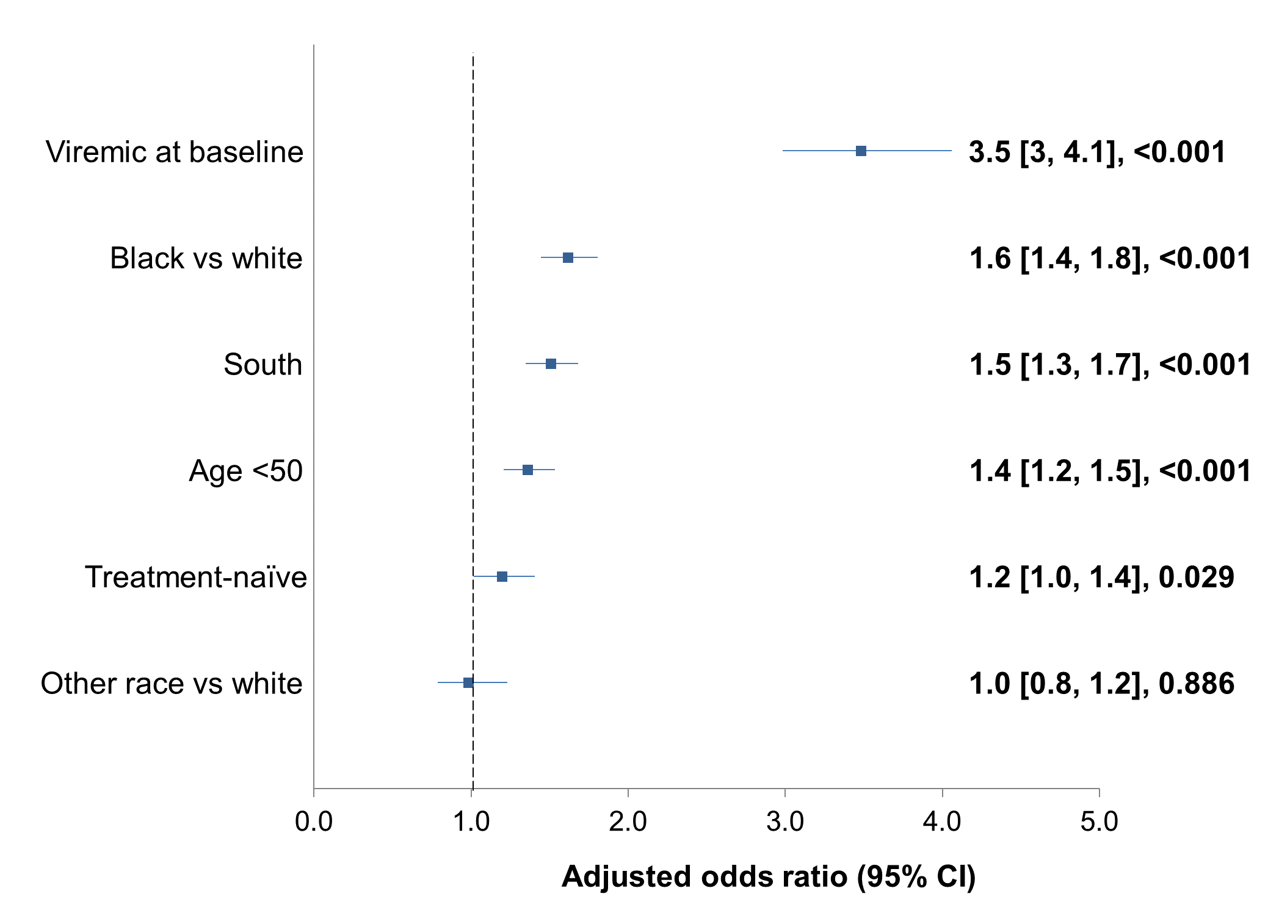

Characteristics of Patients Living with HIV (PLWH) and HIV Treatment Outcomes in Community Practices in Southern vs Non-Southern US Regions
¹Keith Rawlings, MD, ²Paul Sax, MD, ¹Julie Priest MSPH, ³Janna Radtchenko, MBA, ¹Joe Mrus, MD, ⁴Joe Eron, MD, ¹Alan Oglesby, MPH, ⁵Keri Althoff, PhD, ⁶Faith Fletcher, PhD, ⁷Moti Rampogal, MD, ⁸Steven Santiago, MD, ⁹Richard A Elion, MD
¹ViiV Healthcare, Research Triangle, NC, USA, ²Brigham and Women's Hospital and Harvard Medical School, Boston, MA, USA, ³Trio Health Analytics, La Jolla, CA, USA, ⁴University of North Carolina at Chapel Hill, Chapel Hill, NC, USA, ⁵John Hopkins University Bloomberg School of Public Health, Baltimore, MD, USA, ⁶University of Alabama at Birmingham School of Public Health, Birmingham, AL, USA, ⁷Midway Specialty Care Center, Fort Pierce, FL, USA, ⁸Care Resource, Miami Beach, FL, USA, ⁹George Washington University, Washington, DC, USA
1. BACKGROUND
This study evaluated individual characteristics and antiretroviral therapy (ART) prescribing for people with HIV (PWH) seeking care at practices in southern vs non-southern US regions.
Baseline characteristics of treatment-naïve and treatment-experienced groups differed by region [Table 1-2].
Among treatment-experienced, 83% were suppressed at baseline in South vs. 91% in non-South (p<0.001); after ≥12 months, suppression rates were 85% vs. 91%, p<0.001, respectively.
Among treatment-naive with ≥12 months of follow-up, 72% were suppressed in South, 76% in non-South (p=0.008).
Treatment-experienced individuals in the South were less likely to be on a single-tablet regimen than non-South (60% vs. 62%, p=0.021), no differences by region among treatment-naïve (59% vs 58%, p=0.470).
In the logistic regression accounting for race, gender, age, practice region, treatment status, and baseline viral suppression, individuals younger than 50, black or African American vs. white, treated in South region, treatment-naive, or viremic at baseline were more likely to be viremic after ≥12 months. Final model is shown in Figure 2.
2. METHODS
PWH (>18 years old) starting a new ART between January 2015-September 2019 with viral load at first regimen prescription (baseline), and ≥6 months of prior ART history (if not treatment-naive), were selected from Trio Health HIV EMR database.
Comparisons of baseline characteristics were conducted via chi-square for categorical variables and t-test for continuous variables.
Multivariate logistic regression with binary outcome “viremic at last observation” estimated the associations of covariates among those with viral load recorded ≥12 months after baseline (n=12,689).
Regions were defined per US Census and sample availability (South included: TX, FL; Non-South: IL, NM, CA, PA).
FIGURE 2. PREDICTORS OF VIREMIA AT 12 MONTHS
TABLE 2: BASELINE CLINICAL CHARACTERISTICS
n (%) unless specified |  | Treatment Naïve (N=5626) |  |  | Treatment Experienced (N=14645)
 |  | Southern (n=3071) | Non-Southern (n=2555) | p-value | Southern (n=7302) | Non-Southern (n=7343) | p-value
Charlson Comorbidity Index, mean (SD) |  | 3.5 (3.2) n=3071 | 4.3 (2.9) n=2555 | <0.001 | 5.3 (2.9) n=7302 | 5.5 (3) n=7343 | <0.001
Hemoglobin, mean (SD) |  | 13.8 (2) n=2484 | 13.9 (1.9) n=1639 | 0.571 | 14.4 (1.7) n=6055 | 14.6 (1.7) n=5799 | <0.001
Platelets, mean (SD) |  | 131.8 (119.5) n=2528 | 205.9 (101.9) n=1513 | <0.001 | 147.5 (116.8) n=6026 | 224.5 (77.5) n=5771 | <0.001
Protein Urine, mean (SD) |  | 10.1 (17) n=932 | 11.2 (17.7) n=783 | 0.200 | 7.9 (11.5) n=3409 | 11.4 (20.9) n=2392 | <0.001
BMI | Underweight | 132 (5) n=2697 | 84 (4) n=2394 | <0.001 | 181 (3) n=6574 | 127 (2) n=7017 | <0.001
 | Normal | 1189 (44) n=2697 | 1156 (48) n=2394 |  | 2099 (32) n=6574 | 2665 (38) n=7017
 | Overweight | 825 (31) n=2697 | 758 (32) n=2394 |  | 2475 (38) n=6574 | 2680 (38) n=7017
 | Obese | 551 (20) n=2697 | 396 (17) n=2394 |  | 1819 (28) n=6574 | 1545 (22) n=7017
CD4 <200 cells/ml |  | 488 (22) n=2177 | 308 (27) n=1161 | 0.008 | 343 (6) n=5885 | 262 (5) n=4854 | 0.335
eGFR | <60 | 82 (3) n=2516 | 79 (3) n=2483 | 0.004 | 636 (10) n=6278 | 629 (9) n=7222 | <0.001
 | 60-89 | 592 (24) n=2516 | 489 (20) n=2483 |  | 2676 (43) n=6278 | 2759 (38) n=7222
 | 90+ | 1842 (73) n=2516 | 1915 (77) n=2483 |  | 2966 (47) n=6278 | 3834 (53) n=7222
FIB-4 | <1.3 | 1052 (43) n=2444 | 967 (64) n=1519 | <0.001 | 2645 (44) n=6009 | 3558 (65) n=5463 | <0.001
 | 1.3-3.25 | 308 (13) n=2444 | 278 (18) n=1519 |  | 1028 (17) n=6009 | 1472 (27) n=5463
 | >3.25 | 1084 (44) n=2444 | 274 (18) n=1519 |  | 2336 (39) n=6009 | 433 (8) n=5463
Hyperglycemia (glucose ≥1.1 g/l) |  | 93 (11) n=875 | 200 (16) n=1277 | 0.001 | 278 (18) n=1508 | 978 (21) n=4595 | 0.018
Triglycerides ≥1.5 g/l |  | 561 (33) n=1721 | 334 (29) n=1135 | 0.074 | 1802 (42) n=4338 | 1814 (39) n=4693 | 0.005
Hypertension (≥130 mmHg systolic, ≥90 mmHg diastolic) |  | 297 (12) n=2494 | 185 (10) n=1775 | 0.131 | 778 (12) n=6342 | 403 (10) n=4167 | <0.001
HDL-cholesterol <40 mg/dl males, <50 mg/dl females |  | 727 (48) n=1509 | 753 (48) n=1561 | 0.973 | 1611 (38) n=4289 | 1762 (35) n=5099 | 0.003
Arteriosclerotic Cardiovascular Disease (ASCVD) risk >7.5% |  | 96 (20) n=486 | 74 (31) n=235 | 0.001 | 877 (36) n=2461 | 645 (46) n=1406 | <0.001
Suppressed at baseline |  | 0 (0) | 0 (0) | N/A | 6083 (83) | 6686 (91) | <0.001
Cardiovascular Disease (CVD) |  | 534 (17) | 1077 (42) | <0.001 | 2330 (32) | 3411 (46) | <0.001
Diabetes |  | 64 (2) | 91 (4) | 0.001 | 542 (7) | 618 (8) | 0.026
Hypertension |  | 331 (11) | 281 (11) | 0.792 | 1672 (23) | 2035 (28) | <0.001
Renal |  | 40 (1) | 36 (1) | 0.730 | 511 (7) | 457 (6) | 0.059
3. RESULTS
Of 20,271 PWH, 14,645 (72%) were treatment-experienced, 7,302, 50% in South) and 5,626 (28%) treatment-naïve (3,071, 55% in South) [Figure 1].
FIGURE 1. PATIENT SELECTION
N=20271
Other race=Asian, American Indian or Alaska native, native Hawaiian or other Pacific islander
Treatment Experienced
(n=14645)
Treatment Naïve
(n=5626)
Treatment
Experienced
14645 (72%)
Treatment
Naïve
5626 (28%)
4. LIMITATIONS
Limitations of this study are typical of retrospective observational studies: subjects were non-randomized, observers were non-blinded, and some subgroups are small in sample size.
Viral suppression rates at 6 and 12 months since baseline were evaluated regardless of regimen.
Data is limited to treatment centers captured in the Trio database and may not represent treatment patterns and patient characteristics in the entire US. All patients were treated at nationally qualified health centers.
Non-Southern
regions
7343 (50%)
Southern
regions
7302 (50%)
Non-Southern
regions
2555 (45%)
Southern
regions
3071 (55%)
TABLE 1: PATIENT DEMOGRAPHICS
n (%) unless specified |  | Treatment Naïve (N=5626) |  |  | Treatment Experienced (N=14645)
 |  | Southern (n=3071) | Non-Southern (n=2555) | p-value | Southern (n=7302) | Non-Southern (n=7343) | p-value
Age, mean (SD) |  | 39.1 (12) | 37.4 (11.9) | <0.001 | 47.4 (11.9) | 46.6 (12.1) | <0.001
Age >50 |  | 651 (21) | 448 (18) | 0.001 | 3160 (43) | 3091 (42) | 0.148
Male |  | 2290 (75) | 2005 (78) | <0.001 | 5748 (79) | 5877 (80) | <0.001
Race | White | 1461 (48) | 1035 (41) | <0.001 | 3934 (54) | 3946 (54) | <0.001
 | Black | 1218 (40) | 990 (39) |  | 2256 (31) | 1920 (26)
 | Other | 223 (7) | 140 (5) |  | 493 (7) | 402 (5)
 | Unknown | 169 (6) | 390 (15) |  | 619 (8) | 1075 (15)
Payer Type | Commercial | 1014 (33) | 1618 (63) | <0.001 | 3543 (49) | 5296 (72) | <0.001
 | Medicare | 171 (6) | 186 (7) |  | 1177 (16) | 988 (13)
 | Medicaid | 121 (4) | 243 (10) |  | 306 (4) | 397 (5)
 | Other | 648 (21) | 477 (19) |  | 899 (12) | 622 (8)
 | Unknown | 1117 (36) | 31 (1) |  | 1377 (19) | 40 (1)
5. CONCLUSION
These data suggest population differences and treatment disparities between Southern and other US regions. Policy makers should examine structural and societal reasons for these disparities in an effort to reduce or eliminate them.
M. Keith Rawlings, Joe Mrus, Julie Priest, and Alan Oglesby are employed by ViiV Healthcare. Paul E. Sax consults for Gilead Sciences, ViiV Healthcare, Merck, Janssen. He received research grants from Gilead Sciences, Merck, and ViiV Healthcare. Janna Radtchenko is employed by Trio Health. Joseph J. Eron consults for Merck, ViiV Healthcare, Gilead Sciences, and Janssen. The University of North Carolina receives research funding from ViiV Healthcare, Gilead Sciences, and Janssen from which he receives support as an investigator. Keri N. Althoff previously served on a Medical Advisory Board for Gilead Sciences. Moti Rampogal is a consultant for ViiV Healthcare, Gilead Sciences, Janssen, and Merck and received research funding from these companies. He is a speaker for ViiV Healthcare, Gilead Sciences, and Janssen. Steven Santiago serves on the Medical Advisory Board for Gilead and is a Speaker for Gilead and Janssen. Richard A. Elion received grants from Gilead Sciences and Proteus, serves on the Advisory boards for Gilead Sciences and ViiV Healthcare, and is a speaker for Gilead Sciences and Janssen. Drs. Althoff, Elion, Eron, Santiago, and Sax serve on Trio Health’s Scientific Advisory Board.
This study was supported by ViiV Healthcare

